Slide 1
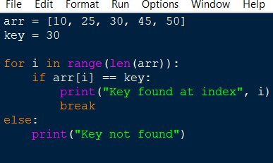

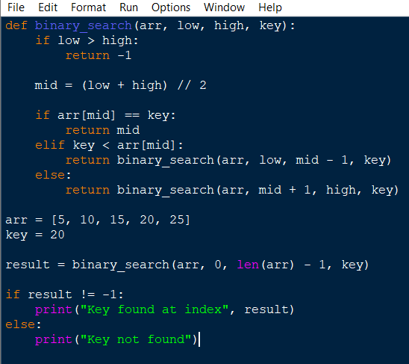

Algorithm Analysis Fundamentals
Time complexity analysis of iterative and recursive algorithms; verify Big-O, Ω, Θ for sample programs
Experiment 1: Linear Search (Iterative)
OUTPUT:
Experiment 2: Binary Search (Recursive)
OUTPUT:

Slide 2
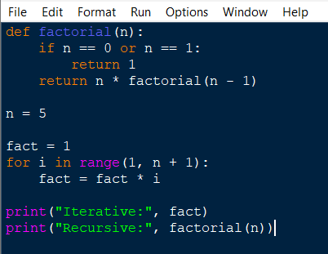

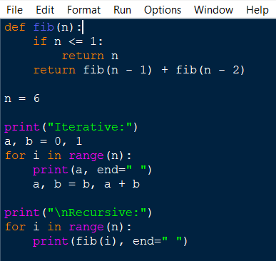
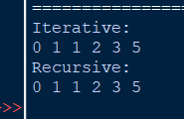
Experiment 3: Factorial (Iterative vs Recursive)
OUTPUT:
Experiment 4: Fibonacci Series
OUTPUT:

Slide 3
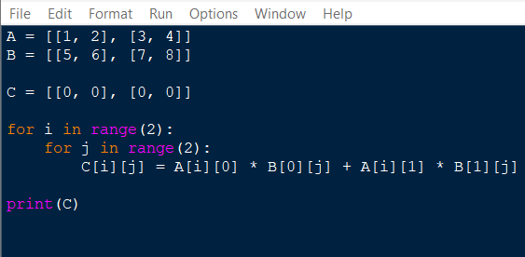

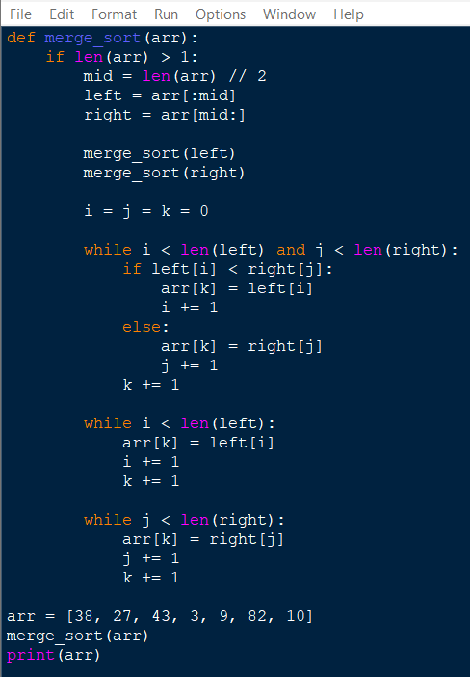

Experiment 5: Matrix Multiplication
OUTPUT:
Experiment 6: Merge Sort
OUTPUT:

Slide 4
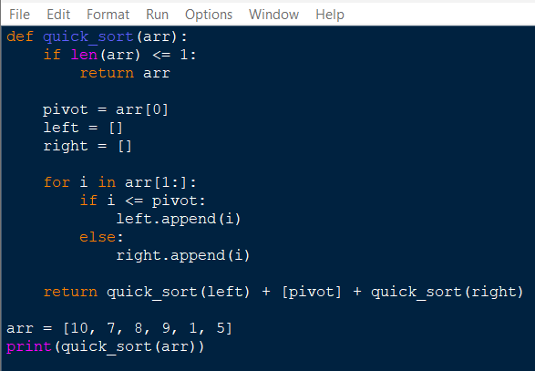

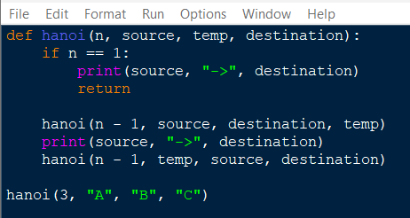
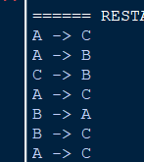
Experiment 7: Quick Sort
OUTPUT:
Experiment 8: Tower of Hanoi
OUTPUT:

Slide 5
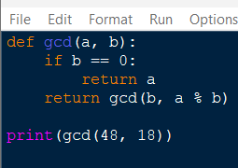

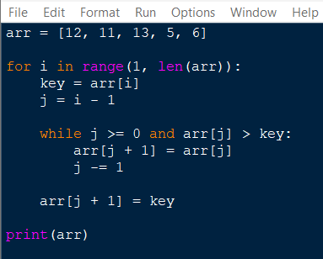

Experiment 9: GCD (Euclidean Algorithm)
OUTPUT:
Experiment 10: Insertion Sort
OUTPUT:

Slide 6
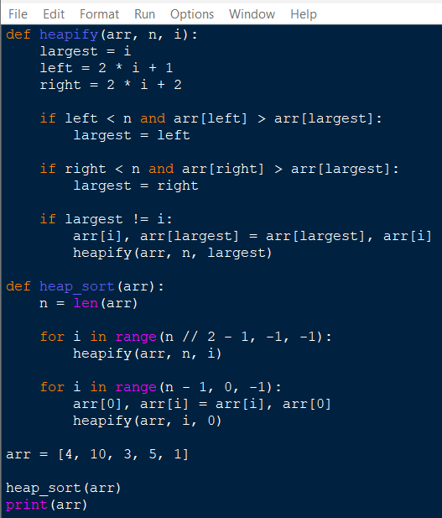

Experiment 11: Heap Sort
OUTPUT:

Slide 7
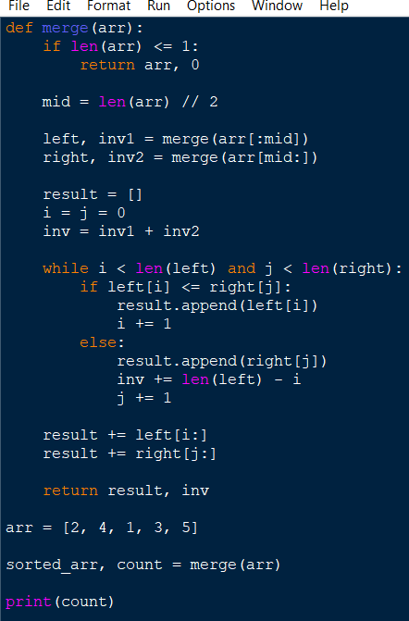

Experiment 12: Counting Inversions
OUTPUT:

Slide 8
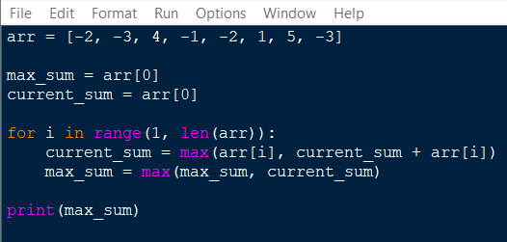

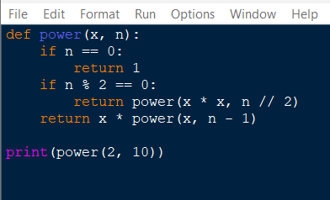

Experiment 13: Maximum Subarray Sum
OUTPUT:
Experiment 14: Exponentiation
OUTPUT:

Slide 9
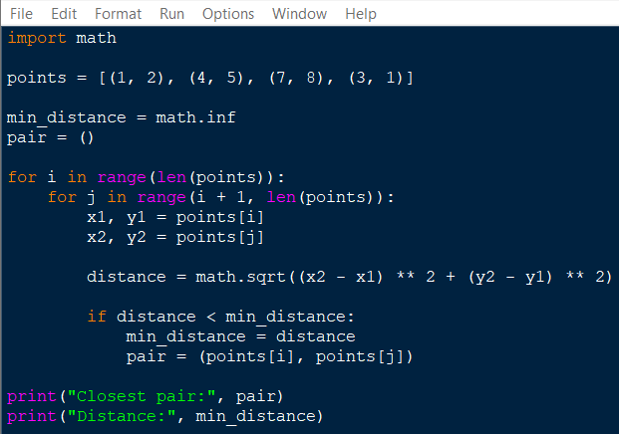

Experiment 15: Closest Pair of Points
OUTPUT:

